Slide 1

Week 2 Key Concepts
NURS 6075
Chris Macintosh, PhD, RN

Slide 2
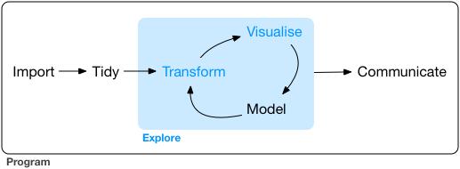
Data Analysis Process – Data Cleaning (Tidy)
Last week we learned how to open a data set in Rstudio.
Before we can do anything meaningful with it we need to make sure it’s suitable to analyze.
Any mistakes in the data identified later in the analysis have to be corrected and the analysis has to be redone from scratch. This is important.

Slide 3

Data Cleaning Steps
Dr. Erin M. Buchanan lists steps to take before analyzing data citing Tabachnick and Fidell (authors of a well-known advanced statistics text).
Check and fix accuracy of the data.
Assess and address missing data.
Examine and decide what to do with outliers.
Assess statistical assumptions.

Slide 4
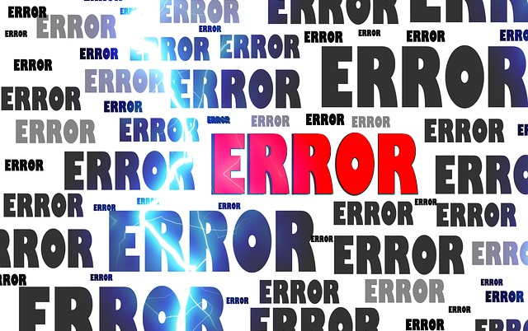


Data Accuracy
Score instruments if needed
Reverse score items if needed
Check for typos
Look for nonsensical data
Make sure data types are correct
Convert variables to factors
Check categories are appropriate
Check counts in categories
Correct problems if possible or delete so it’s missing
Be transparent about problems encountered and how solved

Slide 5

How to Check Data
Data viewer in Rstudio View()
Histograms
Box plots
Scatter plots
Descriptive statistics

Slide 6
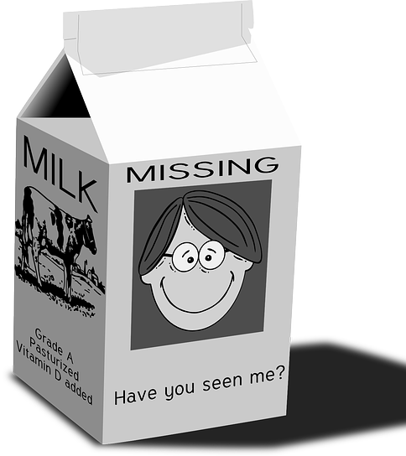
Missing Data
Complex topic
R for Data Science 5.2.3, 7.4
Missing Completely at Random (MCAR) is good
Accidental mistake here and there (no pattern)
Missing Not at Random (MNAR) is bad
Something happened for specific reason (pattern)
Choose to exclude from analysis or impute
Imputing < 5% of large data set considered acceptable
> 5% missing or small data set – imputation probably shouldn’t be done
We won’t impute in this course (complex)

Slide 7

Outliers
We’ll talk more about outliers later
Univariate – z-scores
Multivariate – Mahalanobis distance
Plots
Need to decide to keep in analysis or drop
Have a justification
Be transparent

Slide 8

Probability
One shortcoming of the Field text is the lack of a chapter on probability.
I added some videos and readings which are relevant, although we won’t do a lot of exercises with it.

Slide 9
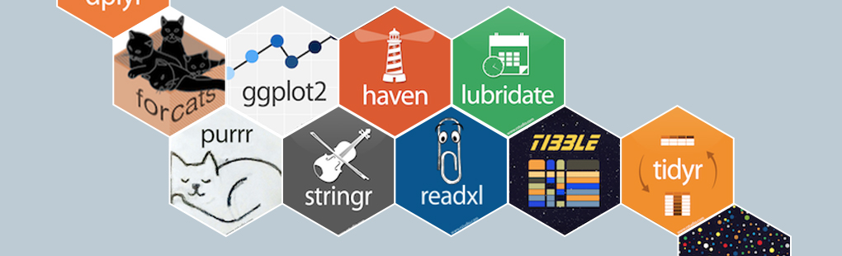
Note about R and the Tidyverse
There are many ways to accomplish the same task in R.
One challenge when searching for solutions is the multitude of options.
One reason for this is R has been around a while and is still evolving.
Sometimes old examples no longer work, or some packages don’t work well together
For this reason I have opted to try to use Tidyverse resources as much as possible (R for Data Science) for this class.
When searching for how to do something in R, I usually include the term “Tidyverse”.
I thought I’d pass that along as you’re learning to do statistics with R.

